Slide 1
SECURITY CHALLENGES IN SMART CONTRACTS
Lucas pelloni
Ile cepilov

Slide 2
Content
Blockchain
What is a Blockchain?
How does it work?
Smart Contracts Introduction
What is a Smart Contract?
Scenario Example
Traditional Contracts vs. Smart Contracts
Possible applications
Ethereum, Blockchain-based Platform

Slide 3
Content
Security Challenges in Smart Contract
Dao Attack
King of the Ether Throne Attack
Multi-Player Game Attack
Rubixi Attack
Govern-Mental Attack
Questions
Discussion

Slide 4
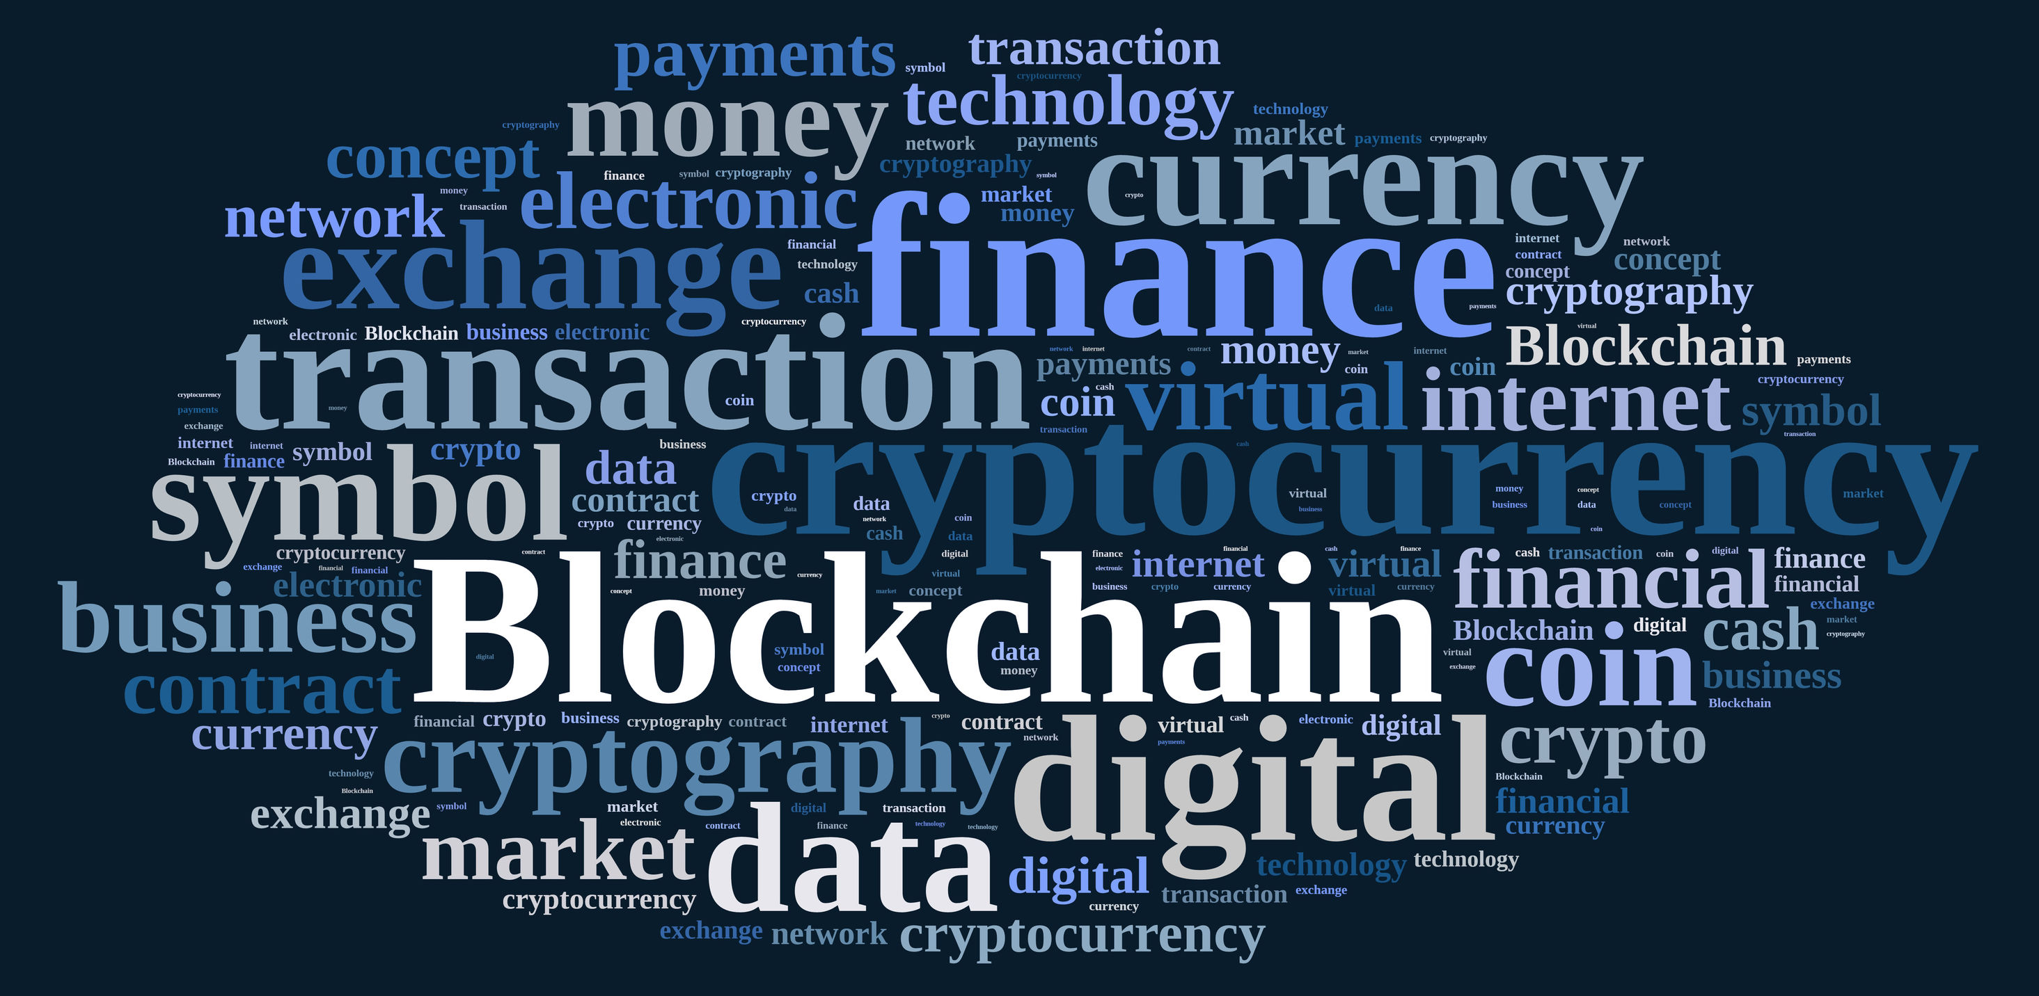
2.1 What is a blockchain AND HOW DOES IT WORK?
Distributed Database
Public digital ledger
Source of Trust

Slide 5





2.2 How does blockchain work?

Slide 6





2.2 How does blockchain work?

Slide 7


2.2 How does blockchain work?

Slide 8
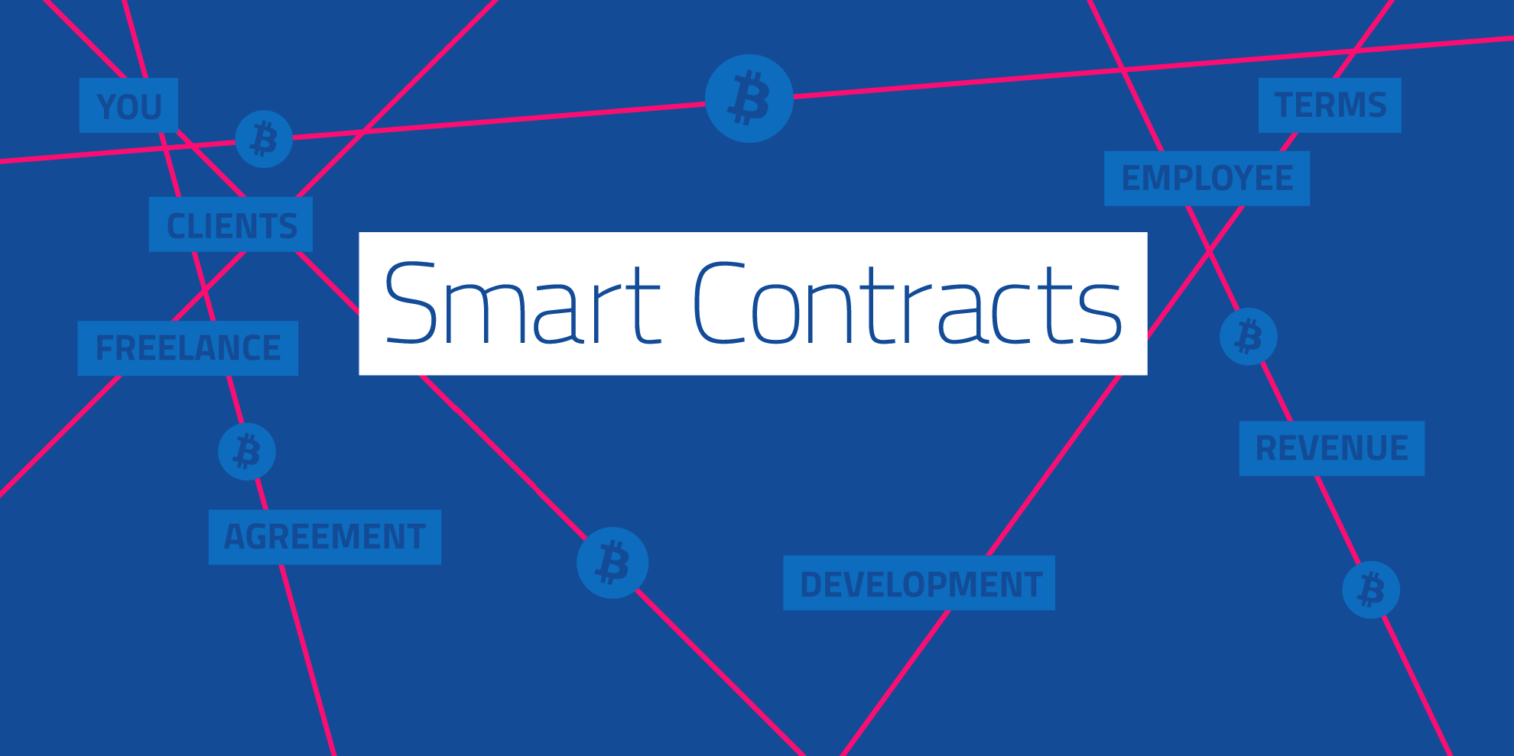

Slide 9
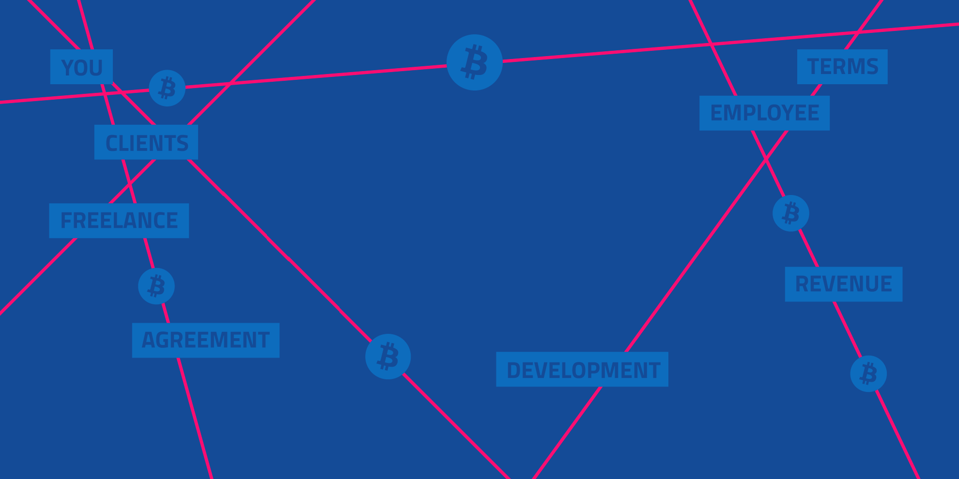
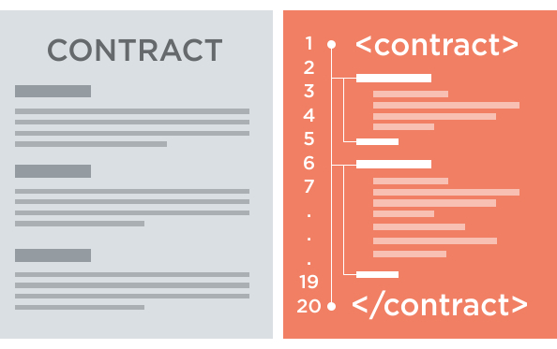
3.1 What is a smart contracT?
A smart contract is a piece of software that defines the rules of an agreement
It automatically verifies itself and executes the terms contained inside it
Stored on the Blockchain

Slide 10
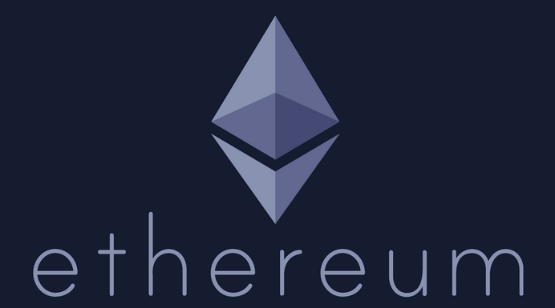
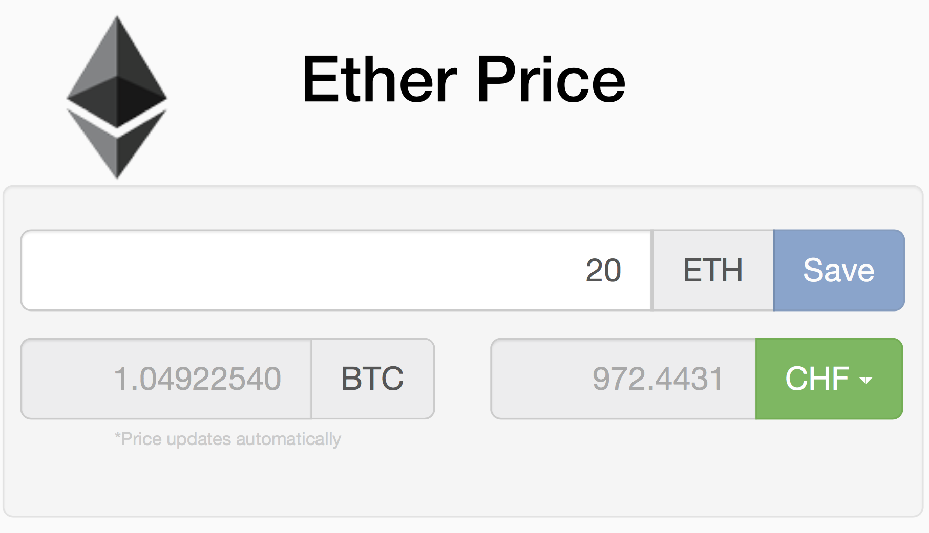
3.2 Ethereum, Blockchain-based Platform
Decentralized platform that runs smart contracts
Custom built Blockchain
Ether
Solidity (high) & EVM (low)

Slide 11
3.3 SMART CONTRACT’S properties IN ETHEREUM
Contract address
Balance
Fallback function()
Variable msg (amount, data)
Gas system
Gas limit
Gas price

Slide 12

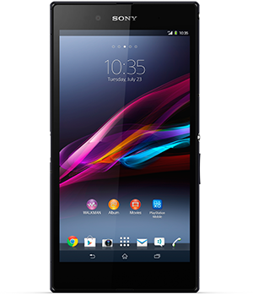
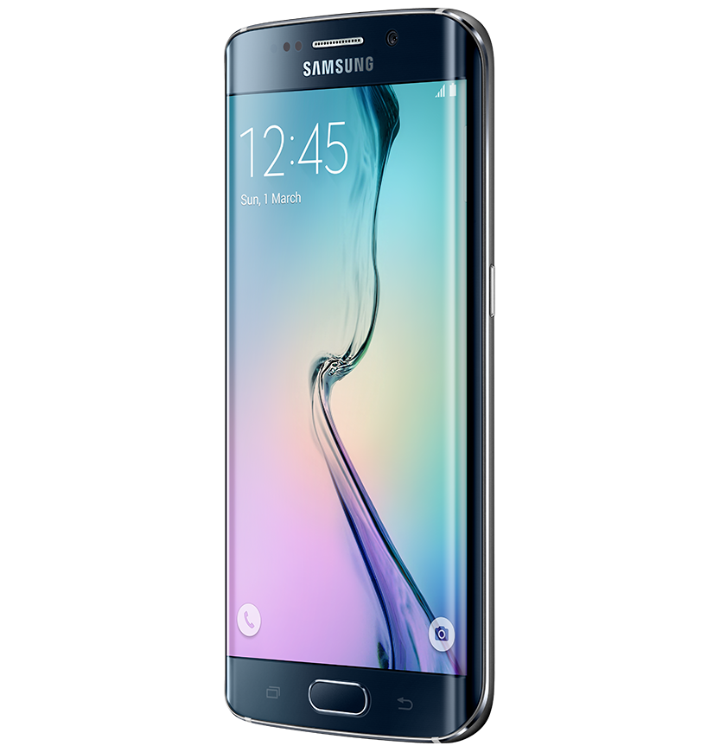

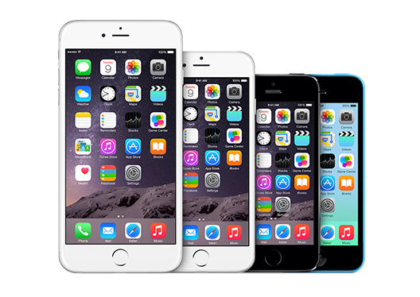
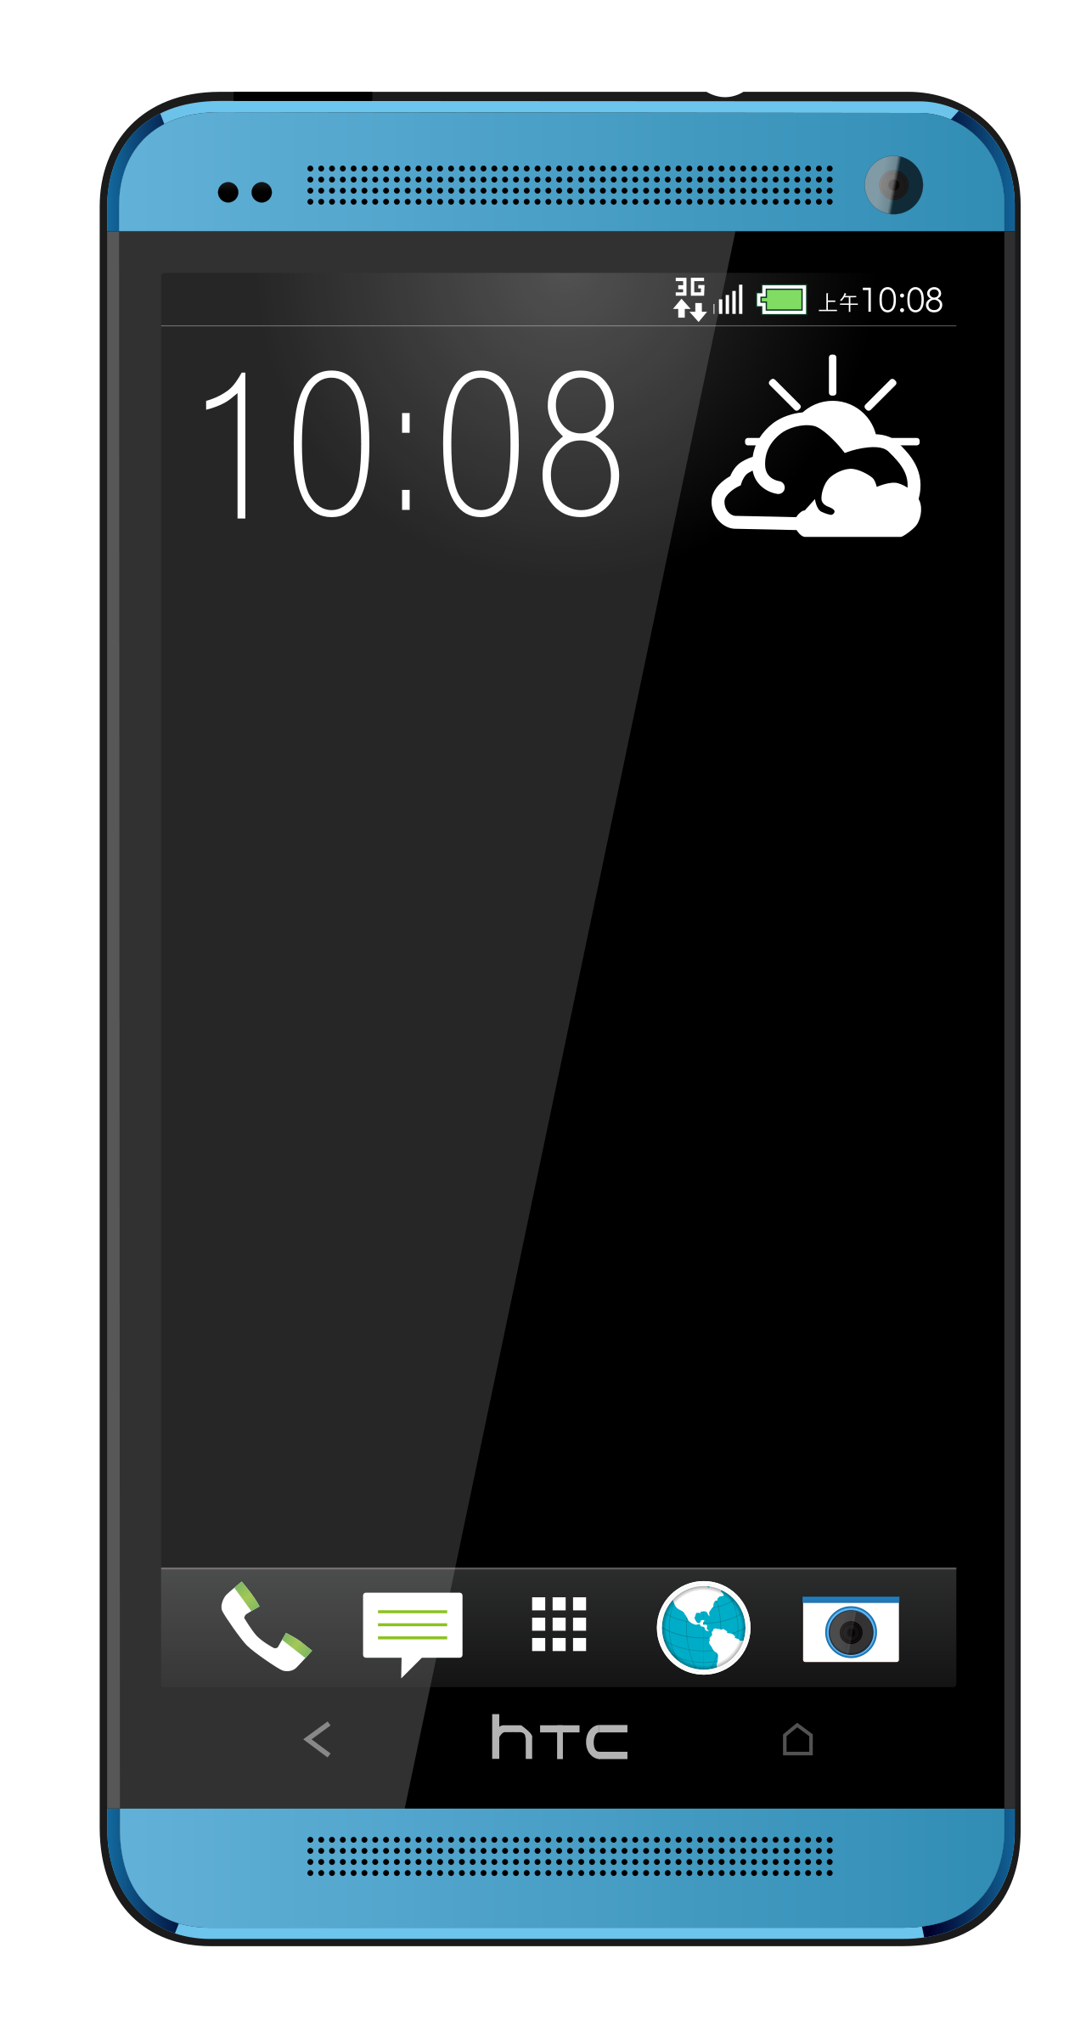
3.4 Scenario Example

Slide 13

3.4 Scenario Example

Slide 14

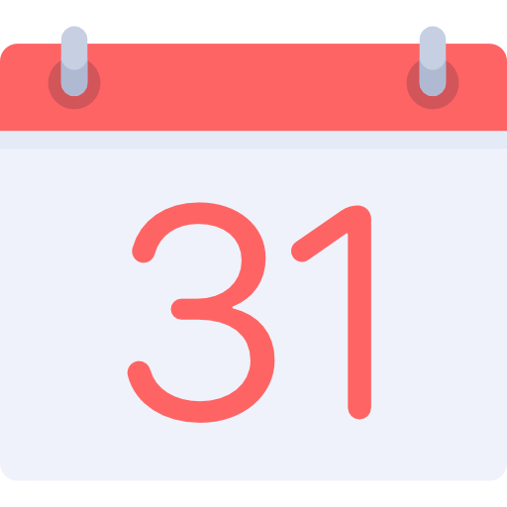




3.4 Scenario Example
I will check
it again in
2 days..
Where is
my phone?

Slide 15



3.4 Scenario Example
I could use
a Smart Contract!

Slide 16
3.4 Scenario Example

Slide 17
3.4 Scenario Example

Slide 18
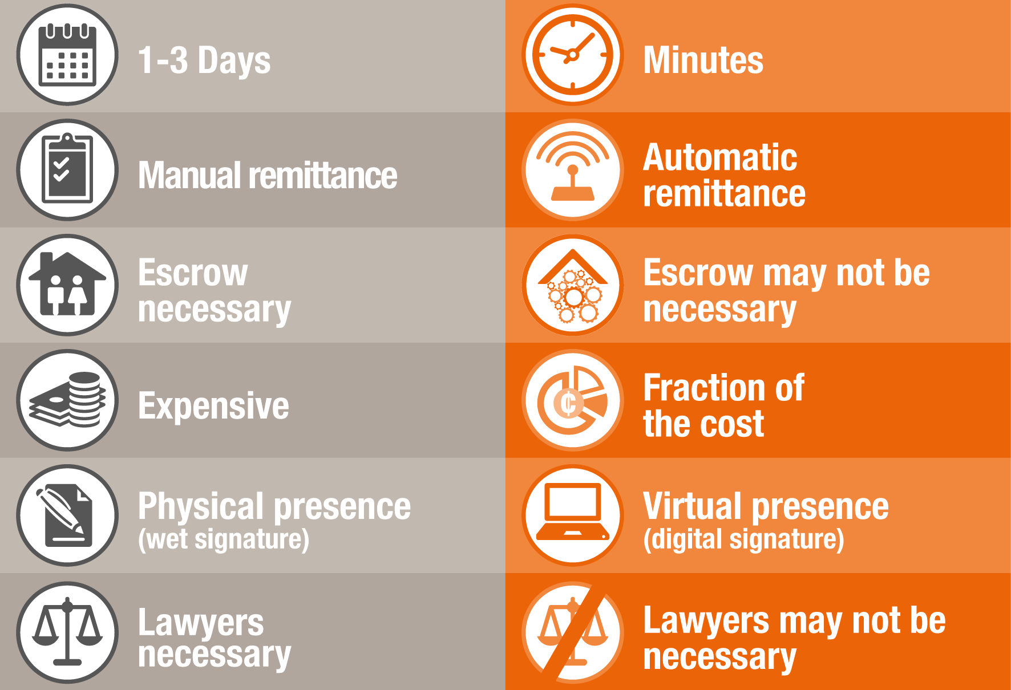
3.5 Traditional ContractS vs. Smart Contracts
TRADITIONAL
SMART

Slide 19
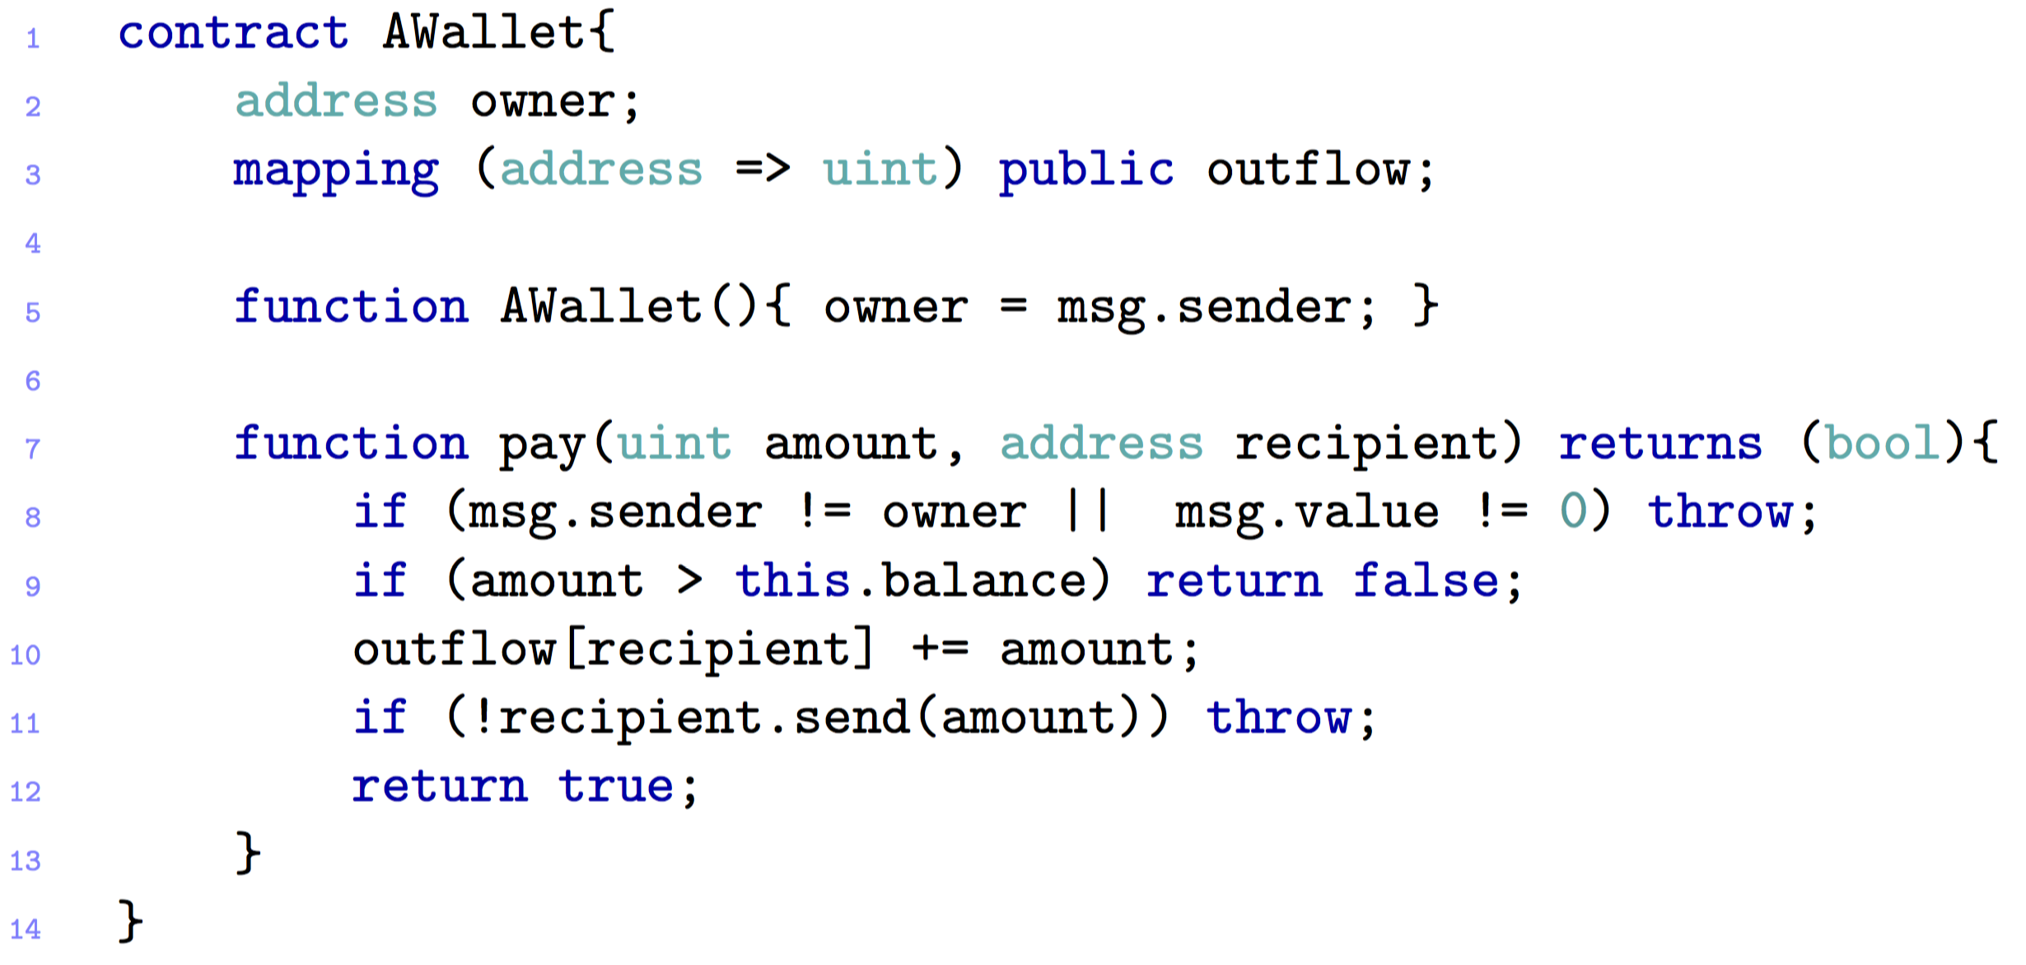
3.6 A simple WALLET CONTRACT

Slide 20
3.7 Possible Applications
Financial services
Coupon payments
Loans (e.g. Leasing)
Life sciences
Electronic medical records
Cross-Industry
Voting

Slide 21

ATTACKS AND
SECURITY CHALLENGES
IN SMART CONTRACT

Slide 22

4.2 MOST FAMOUS ATTACKS – The DAO ATTACK 1
Crowd-funding platform
Attacker managed to put over $60 M

Slide 23
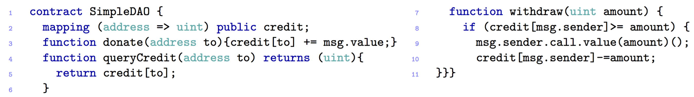
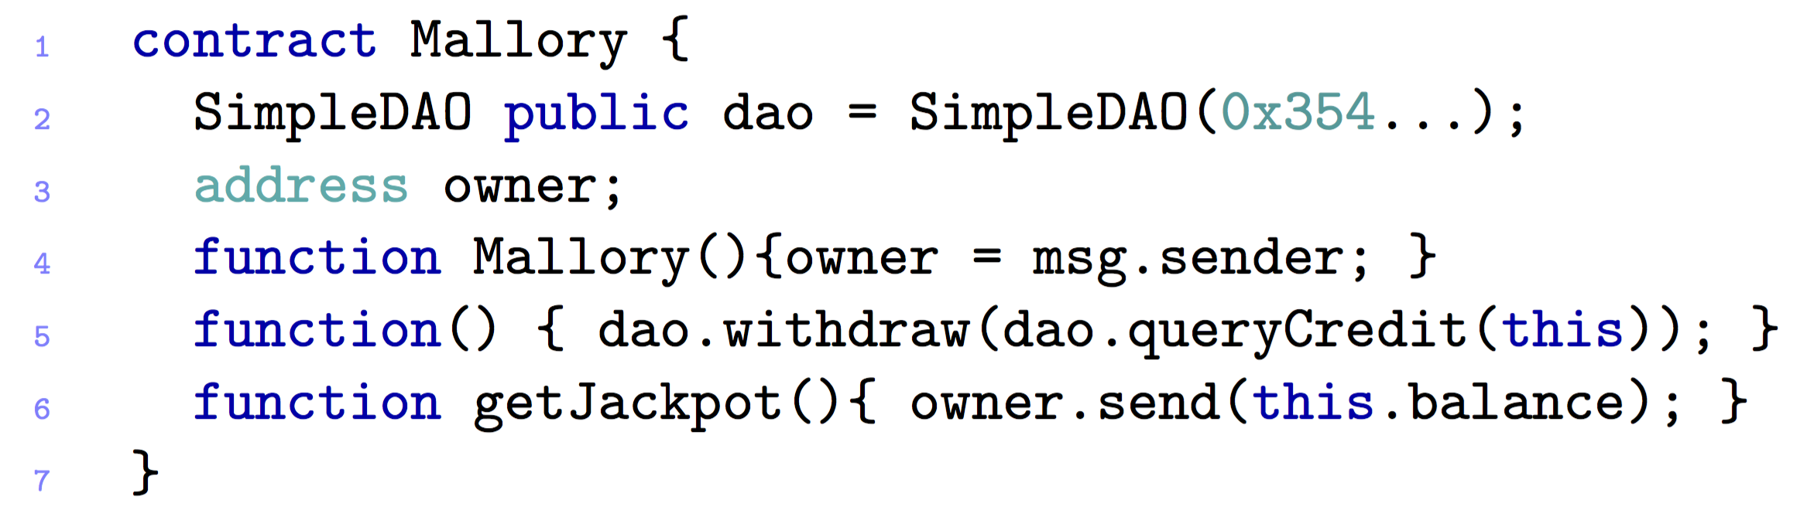
4.2 MOST FAMOUS ATTACKS – The DAO ATTACK – #1

Slide 24
4.2 MOST FAMOUS ATTACKS – The DAO ATTACK 1 – POSSIBLE SOLUTIONS
There are only ways to suppress the attack:
Soft-Fork
Intention: Freeze attacker’s transaction
Miner Majority must accept it
Hard-Fork
Return all the Ether taken from the DAO to a refund Smart Contract
Only one function: “withdraw”
Approved by the community on the 19th July
Completed on the 20th July

Slide 25
4.2 MOST FAMOUS ATTACKS – KING OF THE ETHER THRONE
Game’s goal: become the “King of Ether”
You have to pay the current king and a small fee to the contract
Prize increases each time

Slide 26
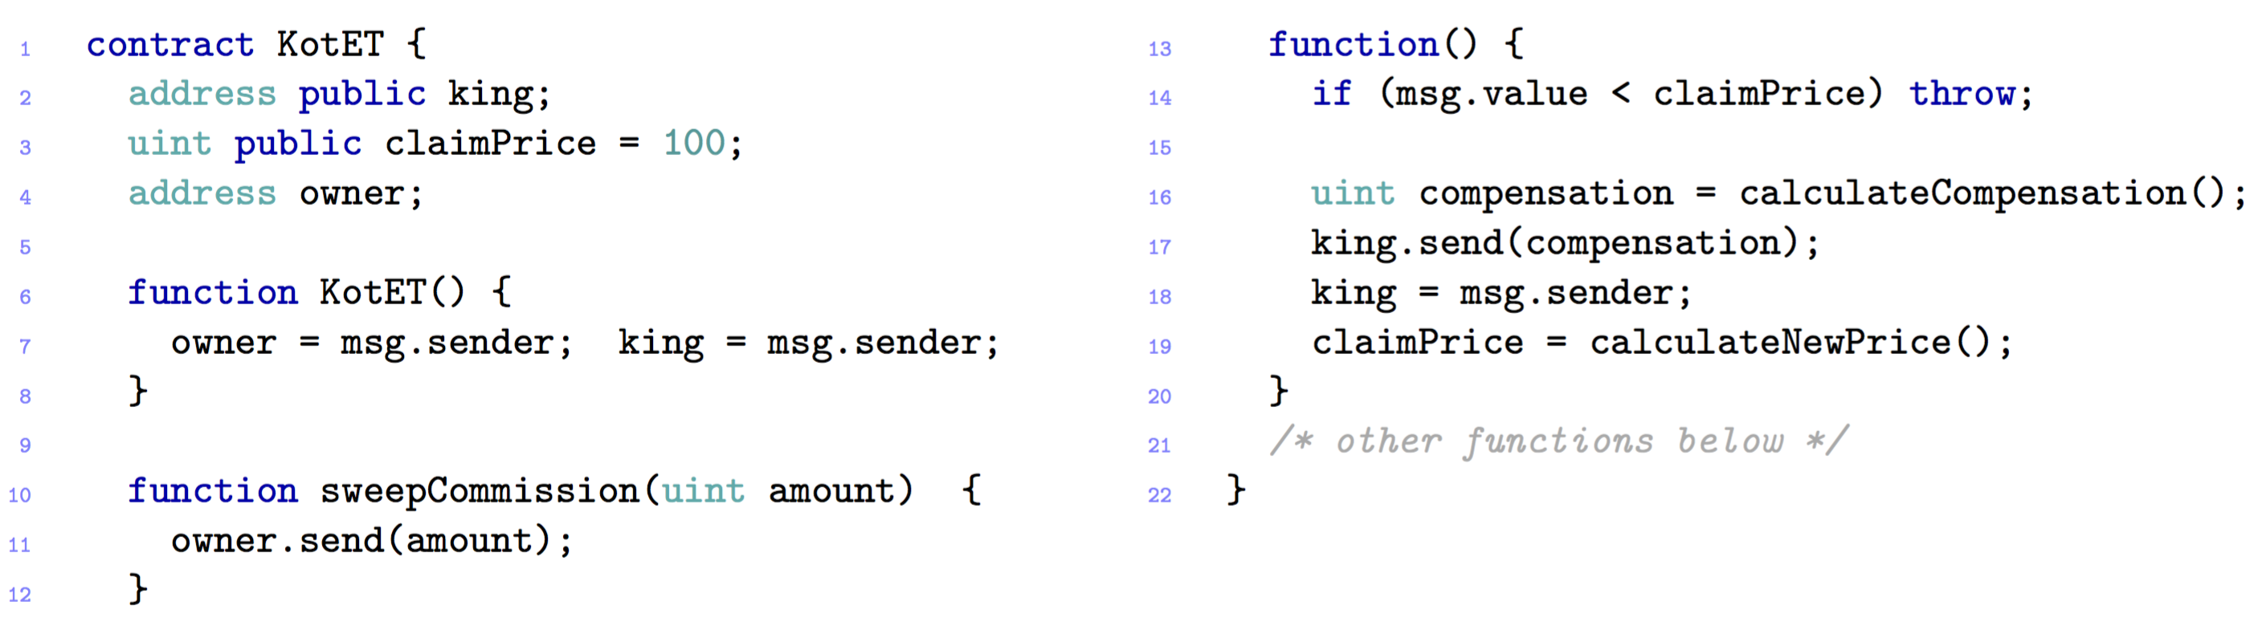
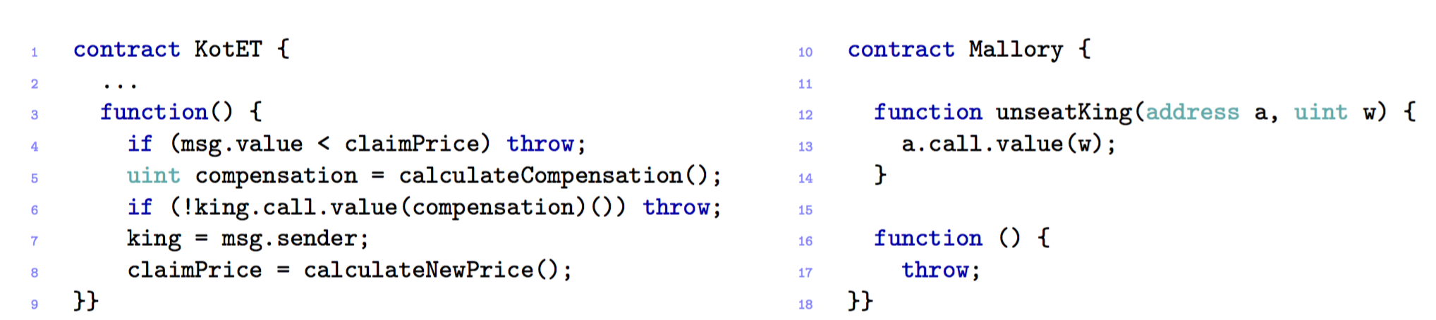
4.2 MOST FAMOUS ATTACKS – KING OF THE ETHER THRONE

Slide 27
4.2 MOST FAMOUS ATTACKS – King Of the ether – POSSIBLE SOLUTIONS
Failed compensation sends
Include more gas with each payment
Exception disorder
Handle exceptions in a uniformly way

Slide 28
4.2 MOST FAMOUS ATTACKS – Multi-player games
Game: odds and evens
Each player chooses a number
Sum is even or odd

Slide 29
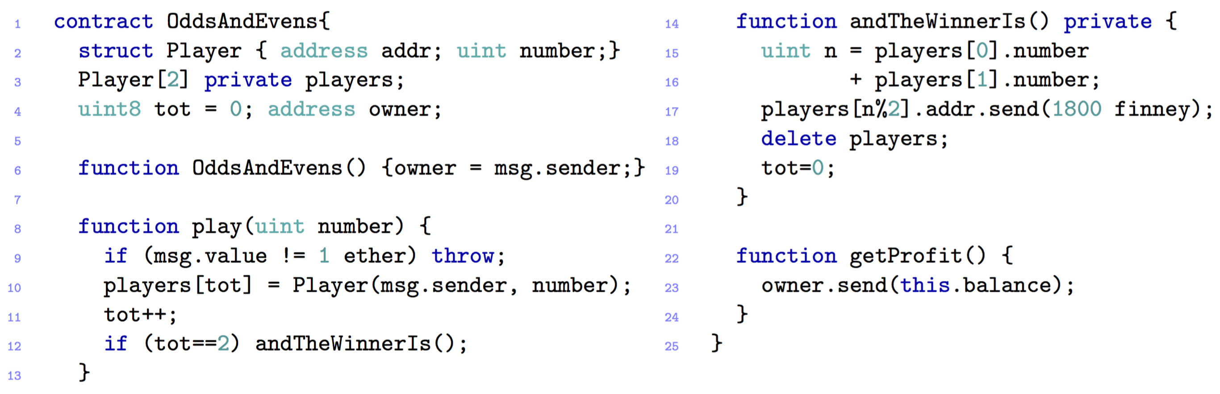
4.2 MOST FAMOUS ATTACKS – Multi-player games

Slide 30
4.2 MOST FAMOUS ATTACKS – Multi Player Games– POSSIBLE SOLUTIONS
Keeping secrets
Cryptographic techniques such as Timed-Commitments
The next player has to play his move within a set time period, otherwise he will get a penalty

Slide 31

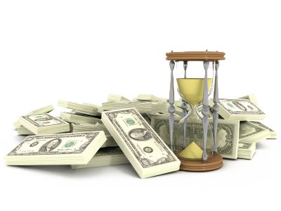



4.2 MOST FAMOUS ATTACKS – RUbixi
Ponzi Scheme, fraudulent investment program
Participants gain money from newcomers
Owner collects fees paid to the contract

Slide 32

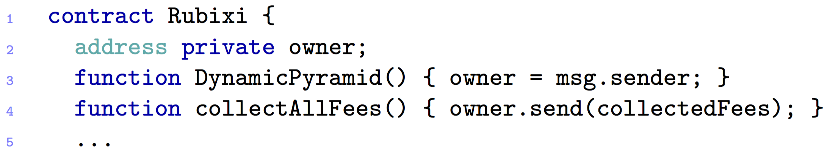
4.2 MOST FAMOUS ATTACKS – RUbixi
Financial

Slide 33

4.2 MOST FAMOUS ATTACKS – Rubixi– POSSIBLE SOLUTIONS
Change the constructor’s name ☺

Slide 34
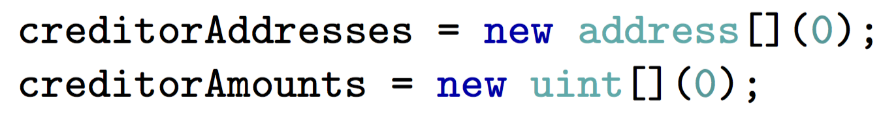
4.2 MOST FAMOUS ATTACKS – Govern-Mental
Ponzi Scheme
To join the scheme, participant must pay a fee
12 hours
Two arrays: list of participants and their credit
After 12 hours:

Slide 35
4.2 MOST FAMOUS ATTACKS – Govern-Mental
…
List grew too long!
Required gas for cleaning the arrays, exceeds the maximum allowed for a single transaction

Slide 36
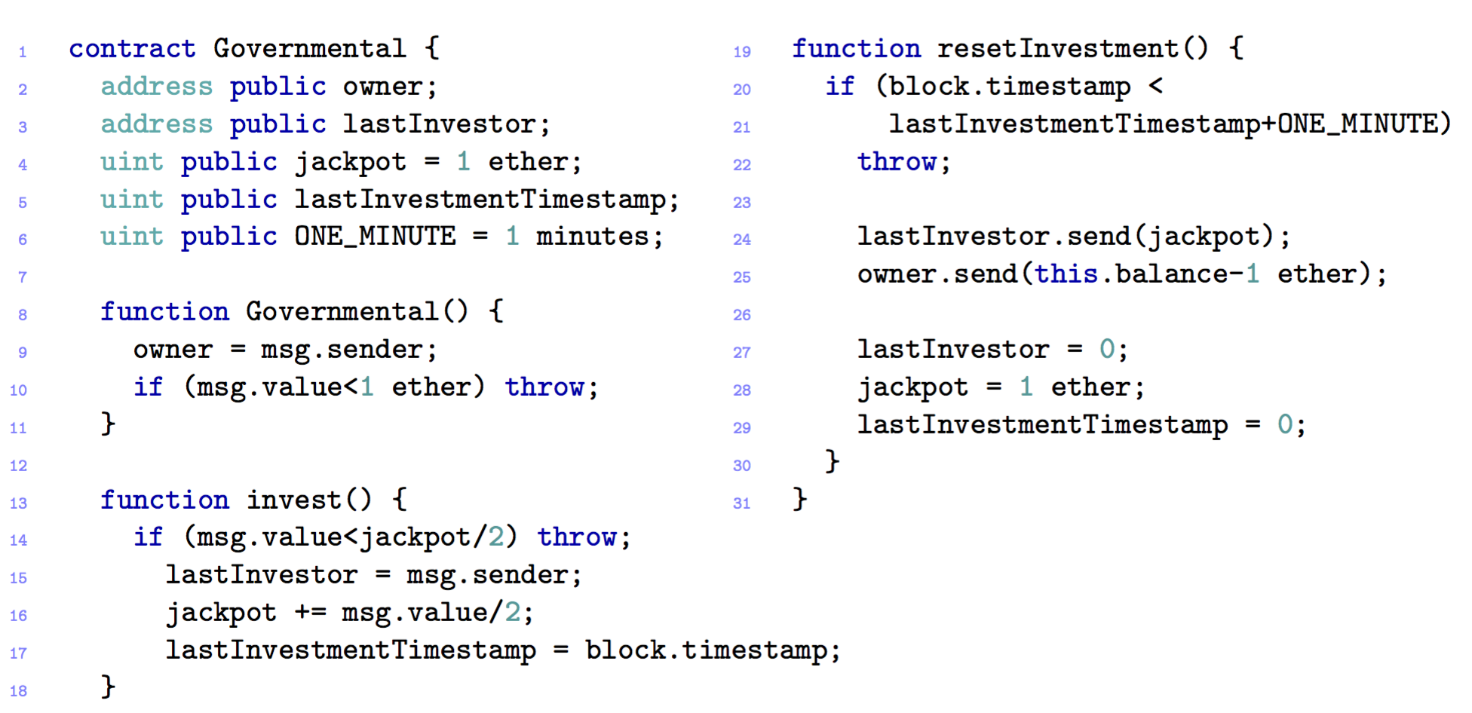
4.2 MOST FAMOUS ATTACKS – Govern-Mental

Slide 37
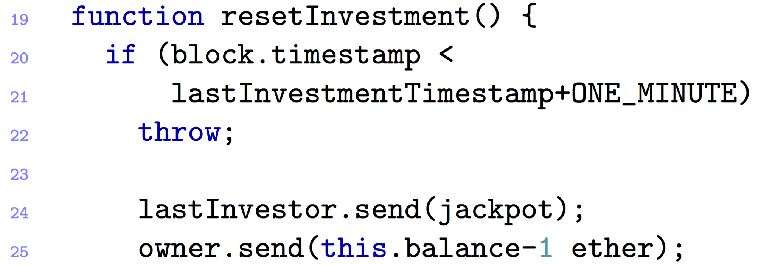

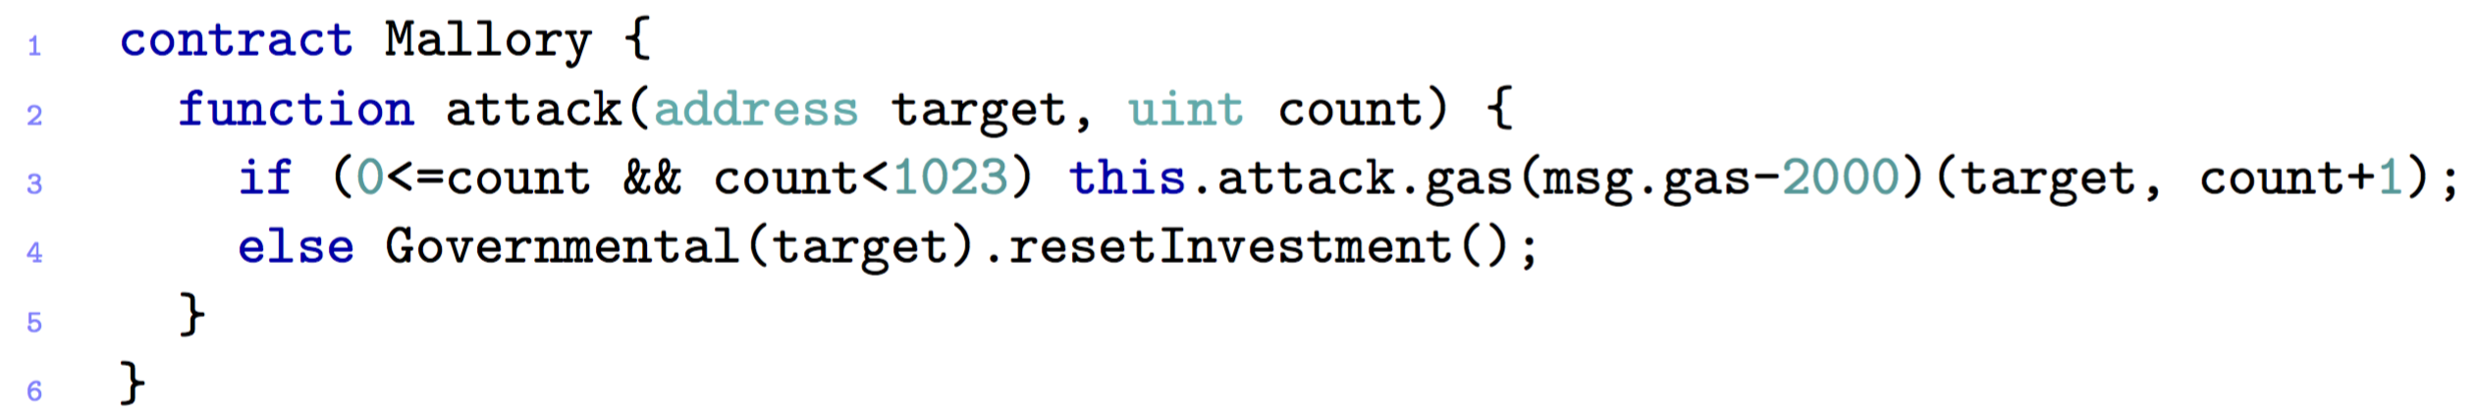
4.2 MOST FAMOUS ATTACKS – Govern-Mental
Must be performed by the owner
Goal: not to pay the winner

Slide 38
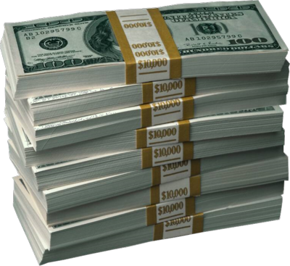
4.2 MOST FAMOUS ATTACKS – Govern-Mental– POSSIBLE SOLUTIONS
Increase cost of external function

Slide 39
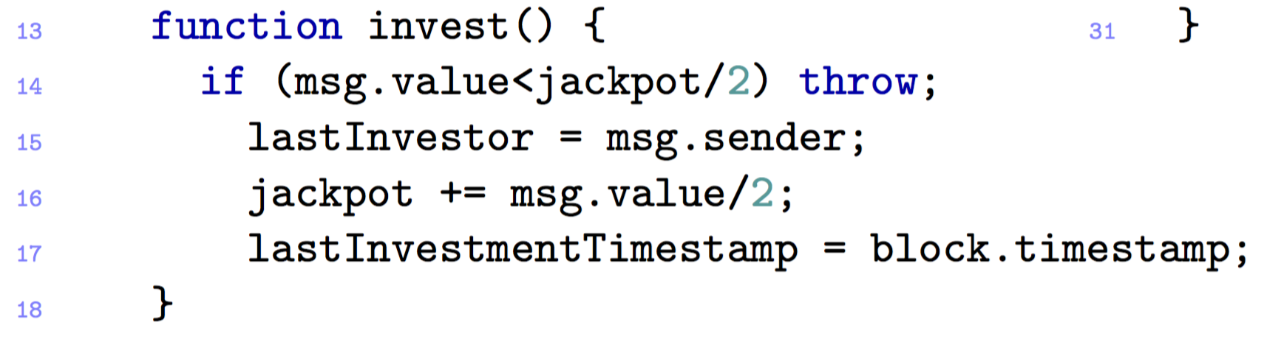
4.2 MOST FAMOUS ATTACKS – Govern-Mental - #2
Attacker does not include in blocks the transactions in order to be the last player

Slide 40
4.2 MOST FAMOUS ATTACKS – Govern-Mental - #3
The miner alters the timestamps
She manages to publish the new block with the delayed timestamp
She will be the last player and win the jackpot

Slide 41
4.2 MOST FAMOUS ATTACKS – Govern-Mental– Vulnerabilities
Stack size limits
Unpredictable state
Time constraints

Slide 42
5.1 OPEN Challenges in Smart Contract
No guarantee of transaction execution
No contractual obligation for miners
Turing-complete smart contracts are slow
contracts can only be executed in sequential order
Oracles break the trust model
Centralized decentralization

Slide 43
5.1 EtherEum Challenges in Smart Contract
Improve Solidity
Documentation is divided across the network and not easily accessible
Trust is a must

Slide 44

Questions?

Slide 45
Discussion – Smart contract Usability
Are there agreements that cannot be completely automatized, i.e. for which you cannot use a Smart Contract?
Can they completely replace traditional contracts?
Are Smart Contracts a really good solution ?

Slide 46
Discussion – Smart contract Security
If yes, in which cases would you prefer Smart Contract over traditional ones?
Would you be willing to rely on a Smart Contract?

Slide 47
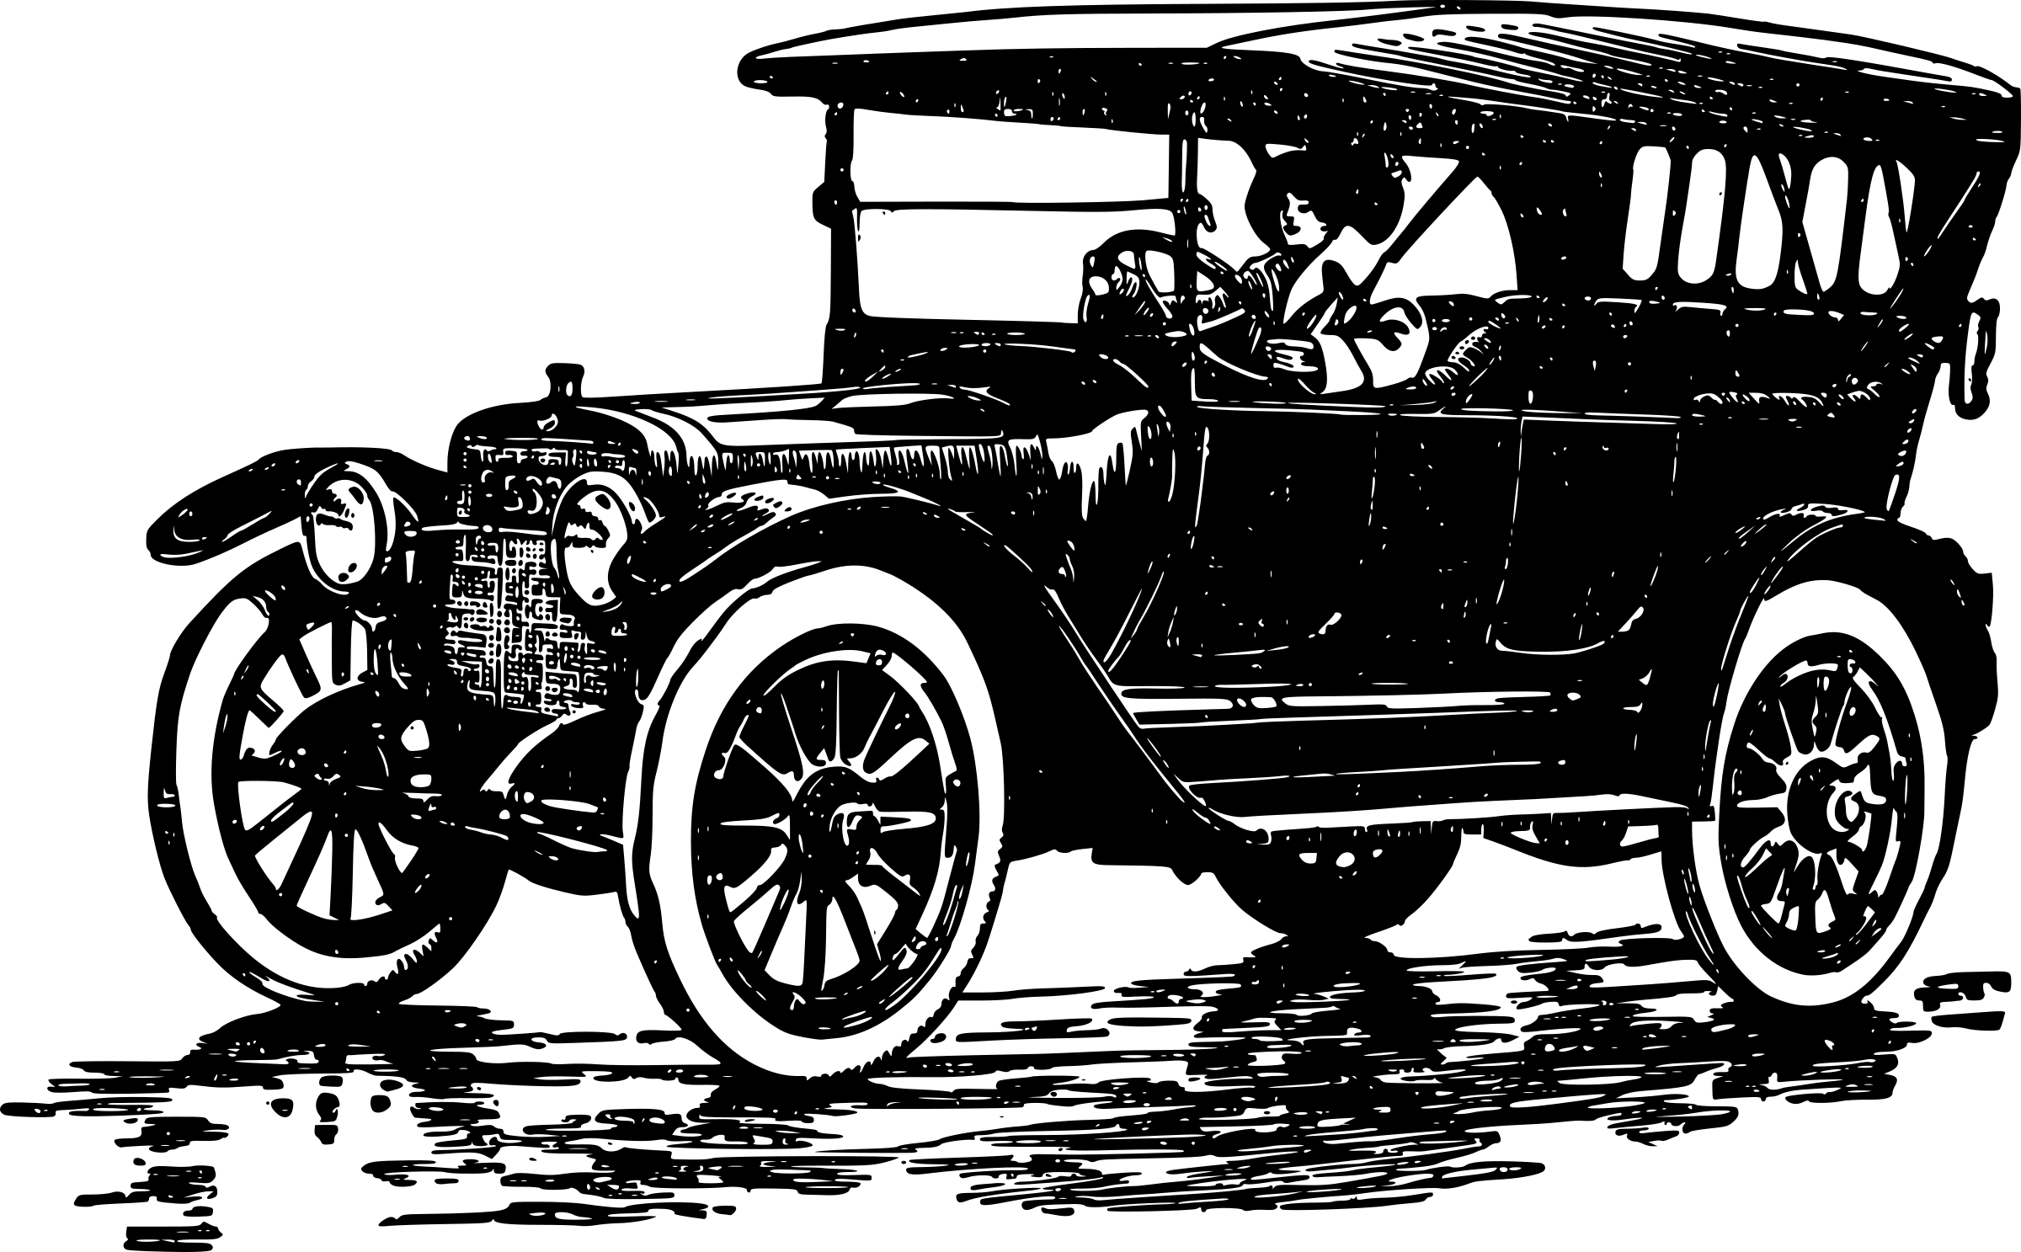
Discussion – Automobile Example
A Family leases a car with a company
The company stipulates a Smart Contract with the Family in order to automate the leasing process
The following conditions are given:
The engine and the main components of the car are controlled by the smart contract
The family has to pay the leasing fee at end of each month

Slide 48




Discussion – Automobile Example
The brakes
do not
work!

